Slide 1
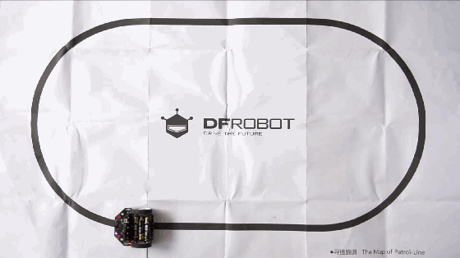
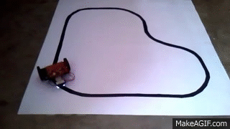

Presented by- Harsh Pallav & Rajat Sharma
Line Follower Robotics Workshop
Create a simple autonomous Line Following Robot.
An introduction to the exciting world of Autonomous Robotics.
DAY 2

Slide 2
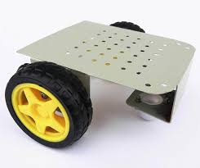
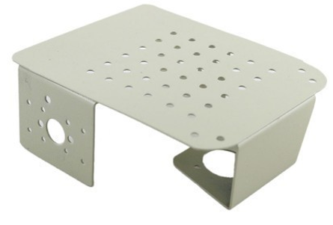
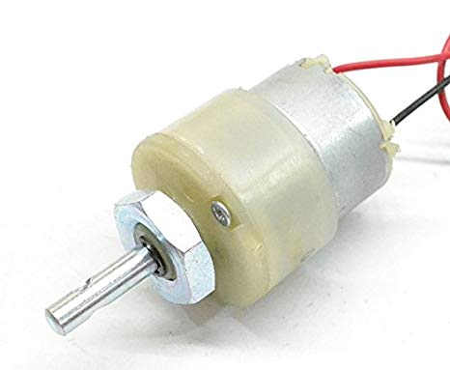
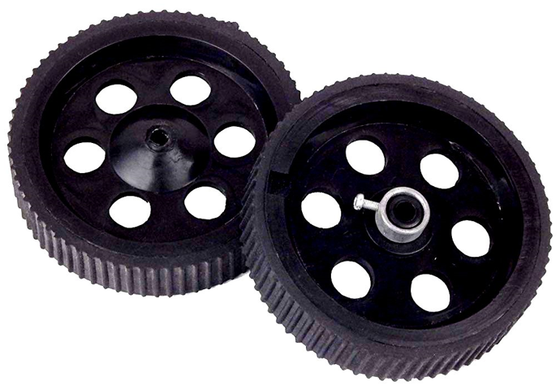
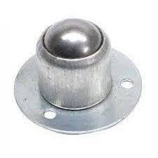


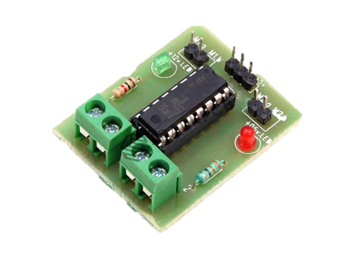
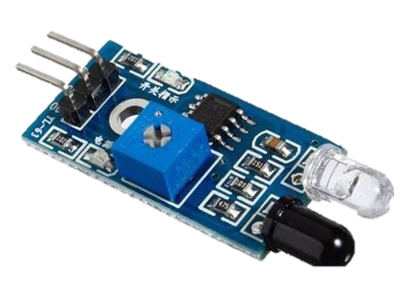

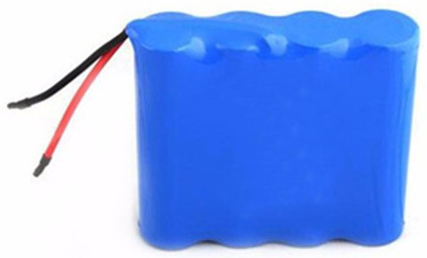
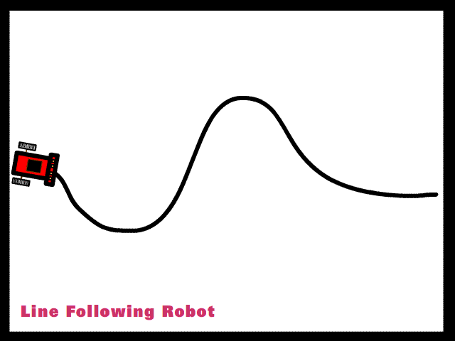
Workshop Flow-
DAY 1- Concept of LFR & Assembly of Robot
Step 1- Chassis
Step 2- DC Motors
Step 3- Wheels
Step 4- Castor Wheel
DAY 2- Programming & Testing of Robot
Step 5- Programming
Step 6- L293D Motor Driver
Step 7- IR Module
Step 8- Power Supply

Slide 3


Slide 4
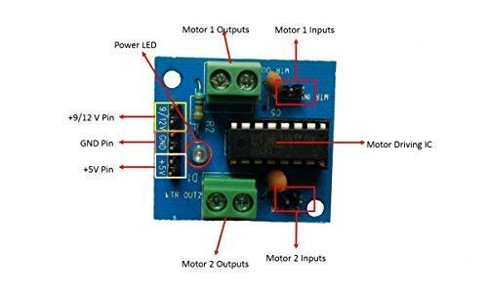
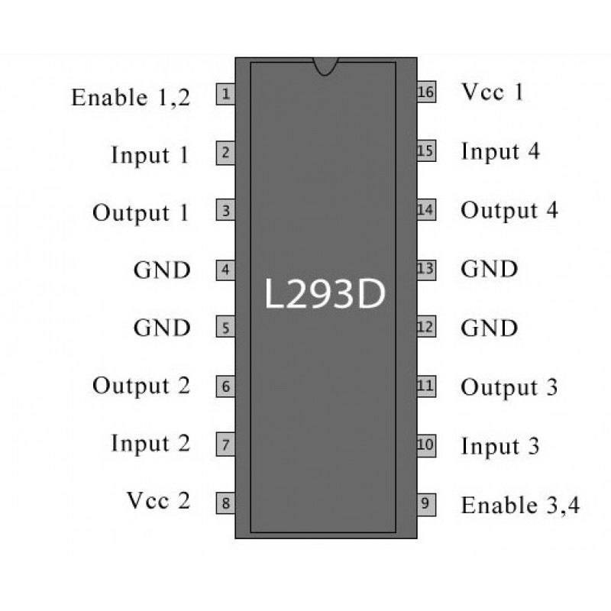
Introduction to Motor Driver-
A motor driver is a breakout board which consist of Motor Driver IC
Motor Driver is use for running the motor
Turn low current signal to high current signal for driving the motor
L293D IC
Motor Driver Breakout Board with L293D IC

Slide 5
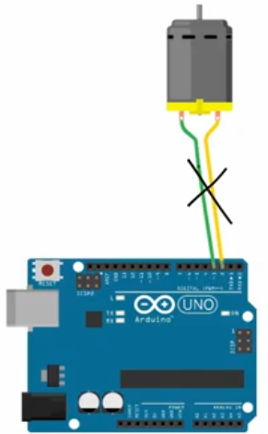
Why Motor Driver ?
The reason we require a motor driver is because components like motors cannot be connected directly to the Arduino as they do not get sufficient power from the Arduino.
So, we first connect the motors to the motor driver and then supply power to the motors using a battery through the motor driver.
There are 16 digital pins on the Arduino board. They can be used as inputs or outputs. They operate at 5V and have a maximum current draw of 40mA.
The L293D is designed to provide bidirectional drive currents of up to 600-mA

Slide 6
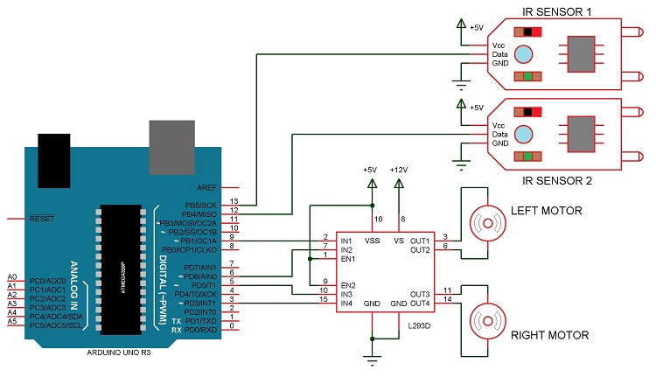
Circuit Diagram-

Slide 7
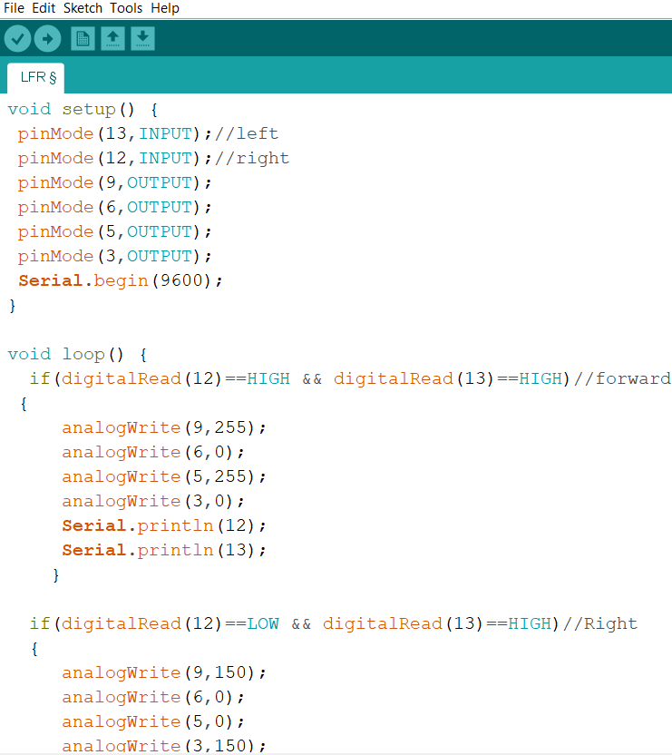
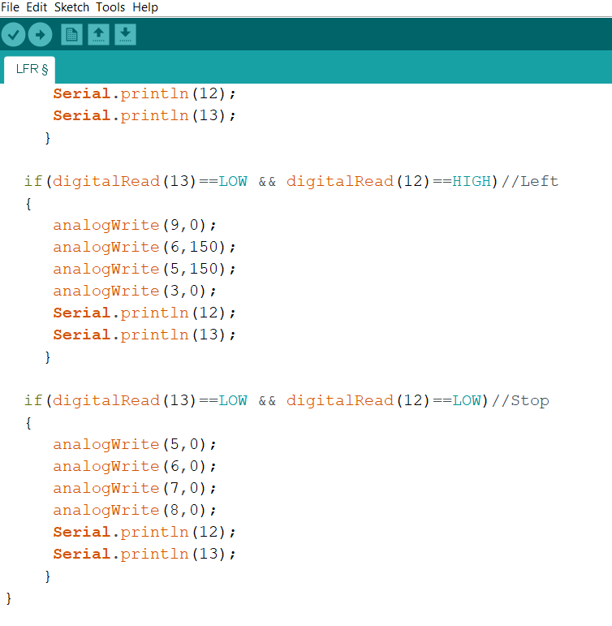
Arduino Code-

Slide 8


Slide 9

END OF WORKSHOP

